Slide 1
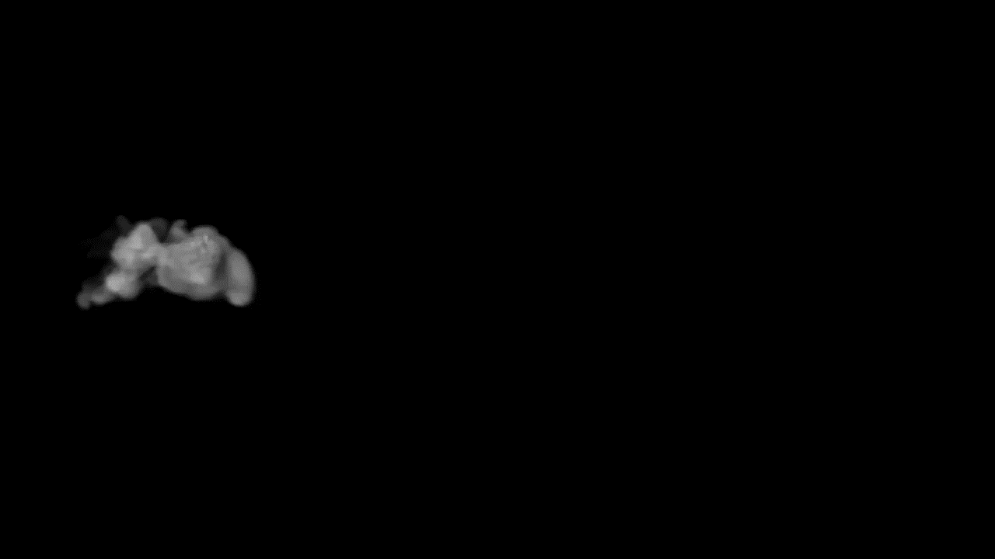

W
E
L
C
O
M
E
WELCOME

Slide 2

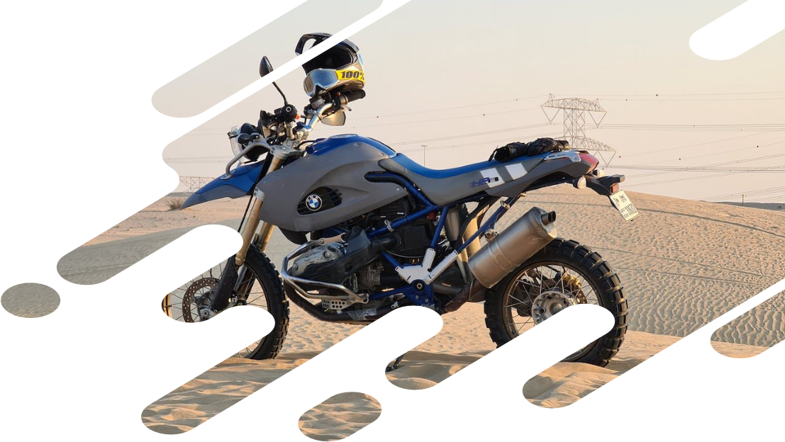
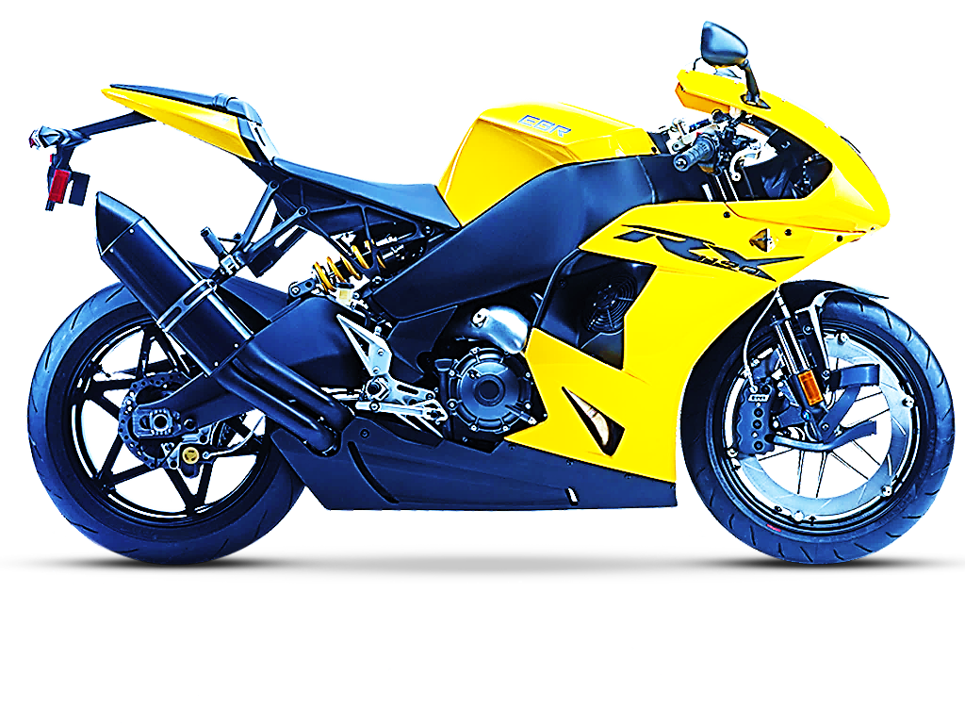
BIKE RENTAL SYSTEM
Let’s Start
Hawana Tamang
Kushal Pathak
Romiya Dangol
Sama Nemkul Shrestha

Slide 3
Table of Contents
Introduction
Problem Statement
Objectives
Scope
System Flow
Waterfall Model
Use case diagram
Significance

Slide 4

Introduction
This system is designed to help the customers to take bike or two –wheelers for rent. When we go on any trip outside the town or country , we want to be free of time so instead of going through buses and taxis, we prefer to have our own vehicle for rent.

Slide 5
Problem Statement
The major problem in manual Bike rental system is that it is time consuming and less efficient.
Long procedure while booking the bike.
Cancellation process in manual system is difficult.
The number of bike rental system are less than the customers who want to ride the bike.

Slide 6
OBJECTIVES
Faster Process
Management
Minimalize paper work
Centralized

Slide 7
SCOPE

Slide 8
MANAGE
Manage the information of bike and the user
INCREASE
To increase the accuracy and efficiency of managing the bike payment.
M
I
This system has the scope of being used in the web version also.
FUTURE
To satisfy the user requirement
SATISFY
F
S

Slide 9
SYSTEM FLOW

Slide 10
Start
Login
Admin
User
Add Bike
Select
Show Bike
Stop
Print Bill
Check Bike
Update Bike
Delete Bike

Slide 11
WATERFALL MODEL
Requirement Analysis
System Design
Implementation
Integration and Testing
Deployment and Maintenance

Slide 12
Use Case Diagram

Slide 13
Bike Rental System
Login
Select
Add
Show
Check
Update
Admin
User
Delete
Bill

Slide 14
Significance
Good Rental Services
Digitalize
Secured Transaction
Security

Slide 15

Conclusion

Slide 16
Thankyou

